Slide 1
Operating System

Slide 2
Memory Management
Ideally programmers want memory that is
large
fast
non volatile
Memory hierarchy
small amount of fast, expensive memory – cache
some medium-speed, medium price main memory
gigabytes of slow, cheap disk storage
Memory manager handles the memory hierarchy

Slide 3
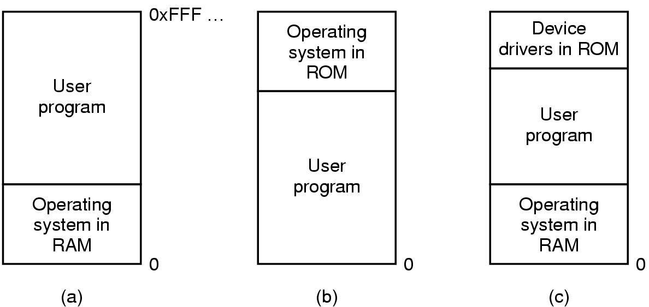
Basic Memory Management Monoprogramming without Swapping or Paging
Three simple ways of organizing memory
- an operating system with one user process

Slide 4
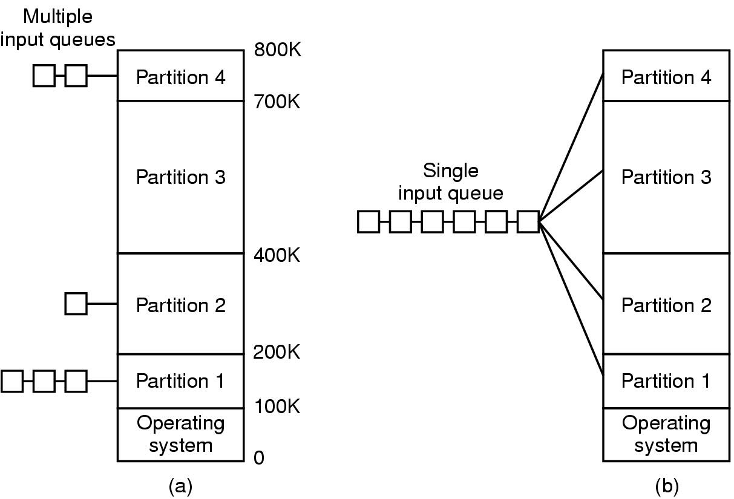
Multiprogramming with Fixed Partitions
Fixed memory partitions
separate input queues for each partition
single input queue

Slide 5
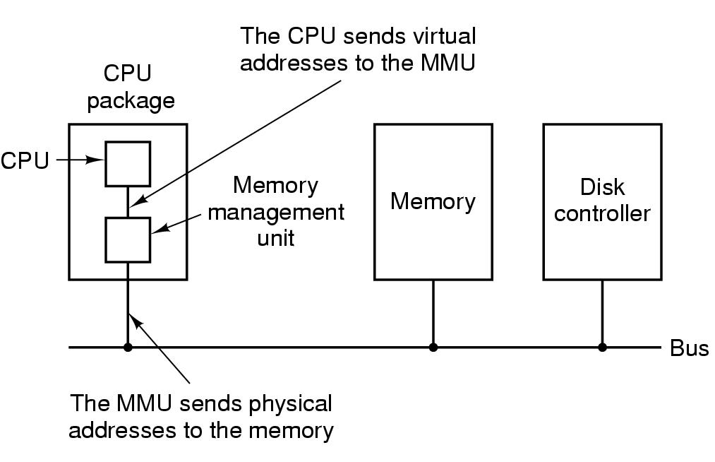
Virtual Memory Paging (1)
The position and function of the MMU

Slide 6
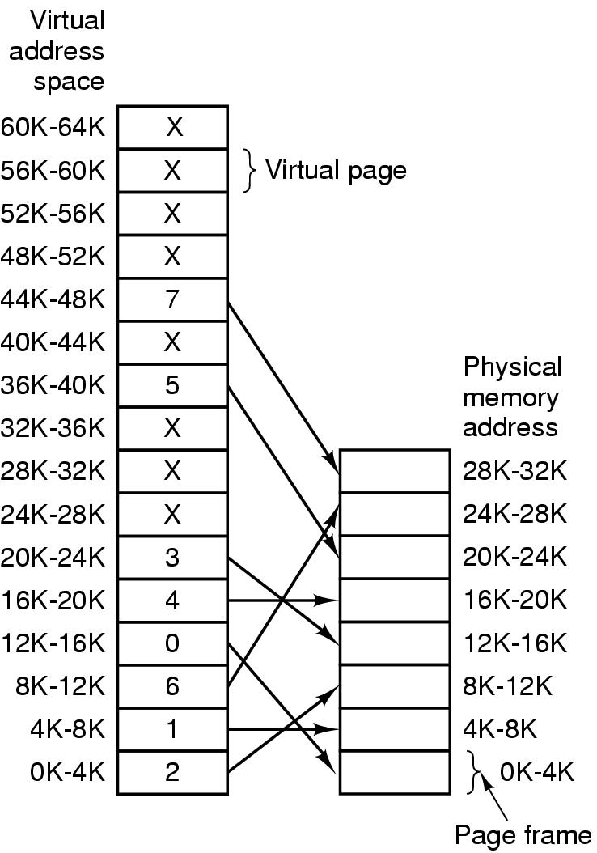
Paging (2)
The relation between virtual addresses and physical memory addres- ses given by page table

Slide 7
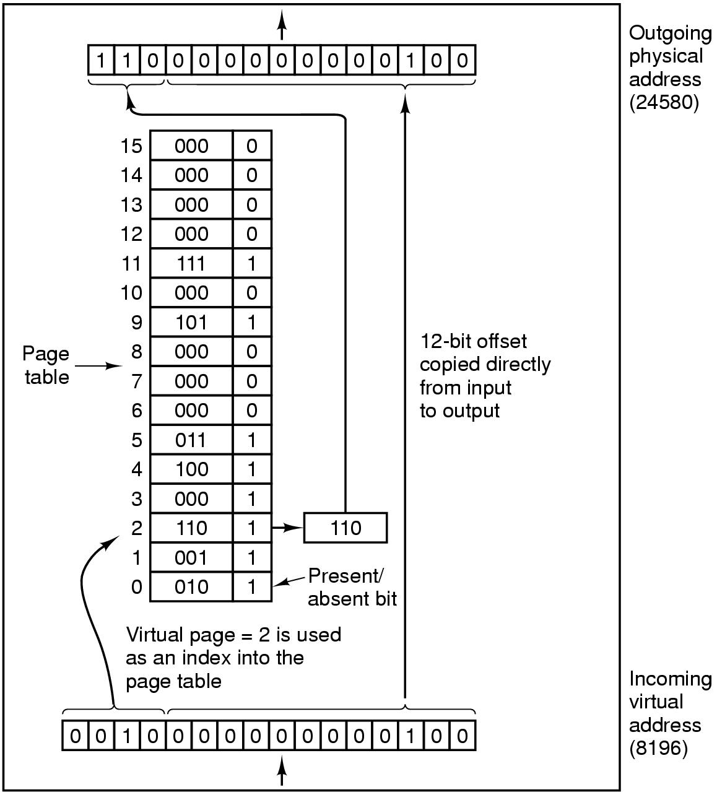
Page Tables (1)
Internal operation of MMU with 16 4 KB pages

Slide 8
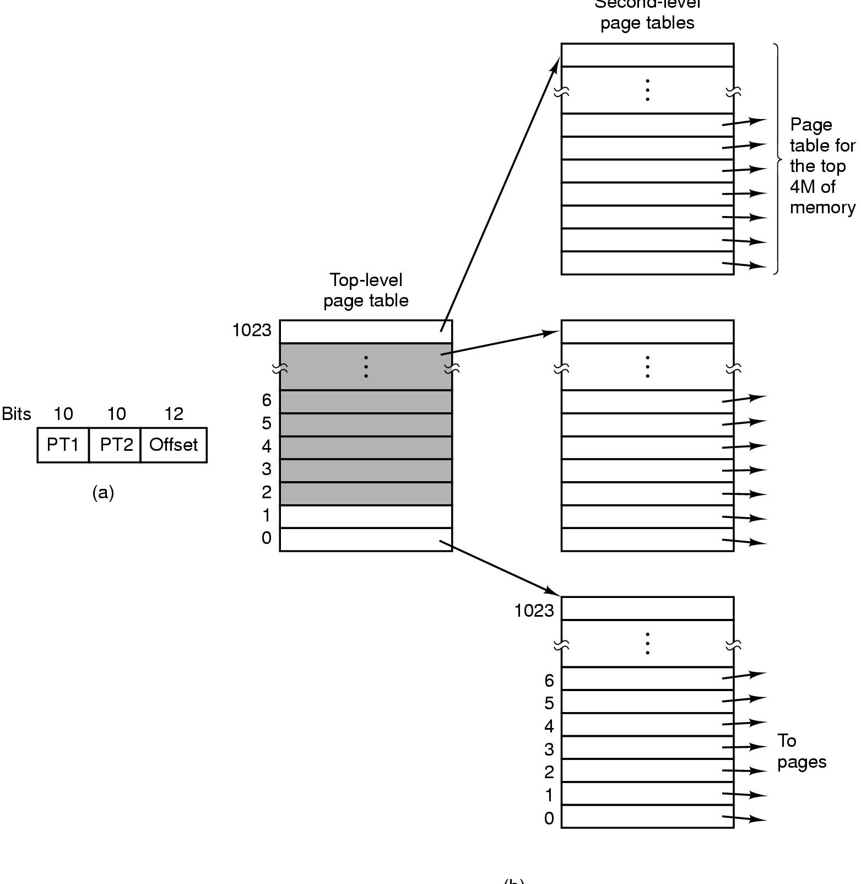
Page Tables (2)
Second-level page tables
Top-level
page table
32 bit address with 2 page table fields
Two-level page tables

Slide 9
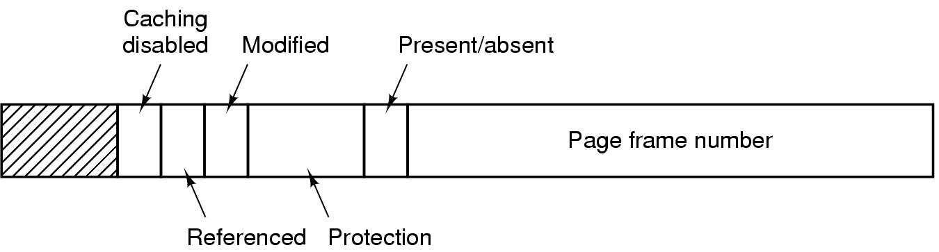
Page Tables (3)
Typical page table entry

Slide 10
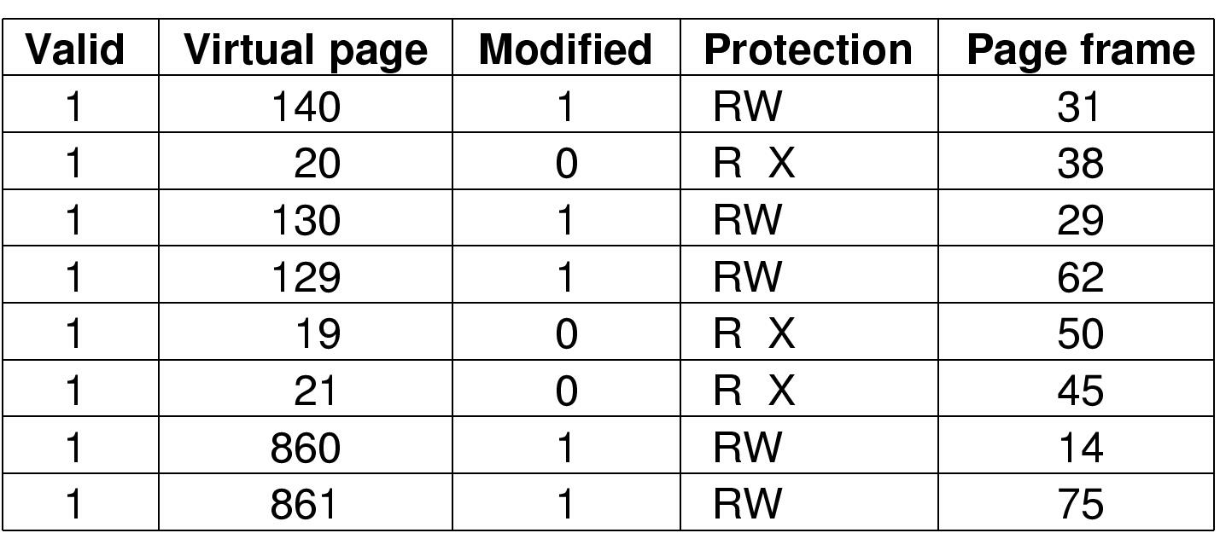
TLBs – Translation Lookaside Buffers
A TLB to speed up paging

Slide 11
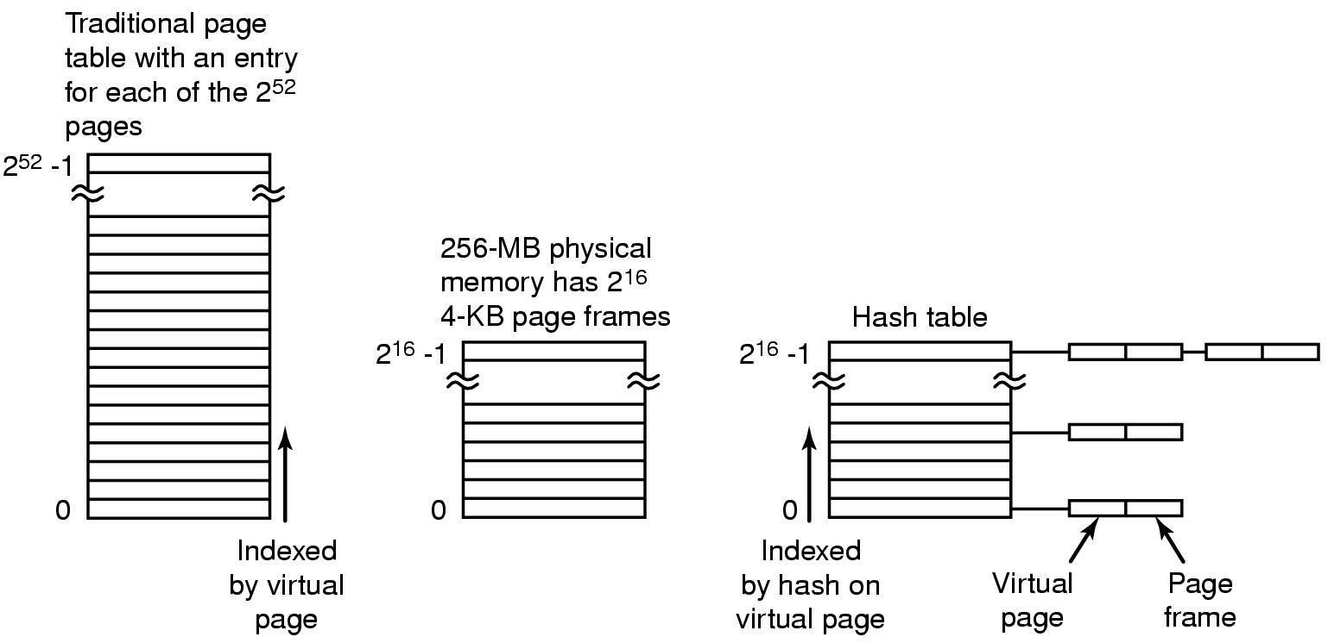
Inverted Page Tables
Comparison of a traditional page table with an inverted page table

Slide 12
Page Replacement Algorithms
Page fault forces choice
which page must be removed
make room for incoming page
Modified page must first be saved
unmodified just overwritten
Better not to choose an often used page
will probably need to be brought back in soon

Slide 13
Optimal Page Replacement Algorithm
Replace page needed at the farthest point in future
Optimal but unrealizable
Estimate by …
logging page use on previous runs of process
although this is impractical

Slide 14
Not Recently Used Page Replacement Algorithm
Each page has Reference bit, Modified bit
bits are set when page is referenced, modified
Pages are classified
not referenced, not modified
not referenced, modified
referenced, not modified
referenced, modified
NRU removes page at random
from lowest numbered non empty class

Slide 15
FIFO Page Replacement Algorithm
Maintain a linked list of all pages
in order they came into memory
Page at beginning of list replaced
Disadvantage
page in memory the longest may be often used

Slide 16
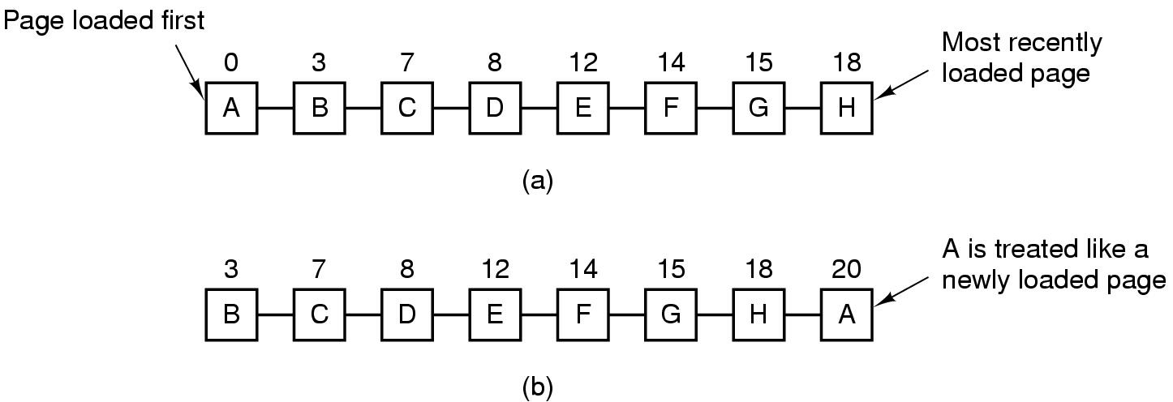
Second Chance Page Replacement Algorithm
Operation of a second chance
pages sorted in FIFO order
Page list if fault occurs at time 20, A has R bit set (numbers above pages are loading times)

Slide 17
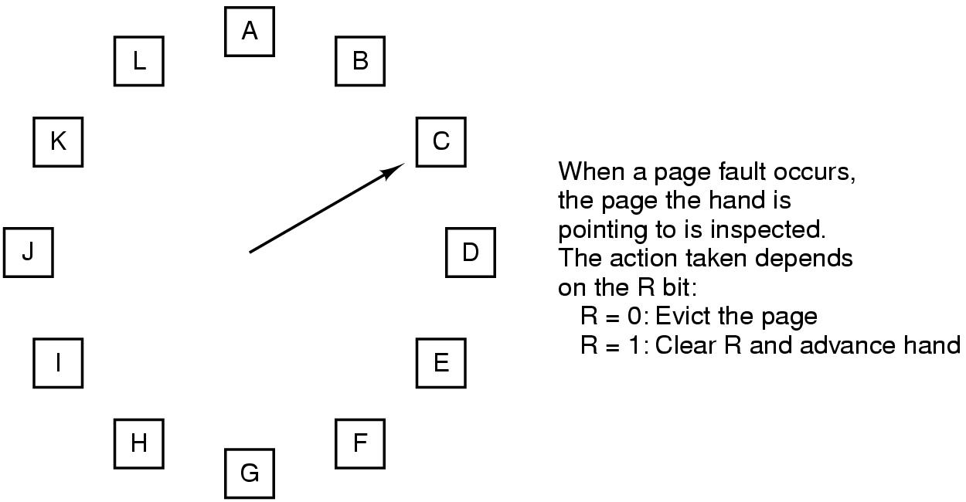
The Clock Page Replacement Algorithm

Slide 18
Least Recently Used (LRU)
Assume pages used recently will used again soon
throw out page that has been unused for longest time
Must keep a linked list of pages
most recently used at front, least at rear
update this list every memory reference !!
Alternatively keep counter in each page table entry
choose page with lowest value counter
periodically zero the counter

Slide 19
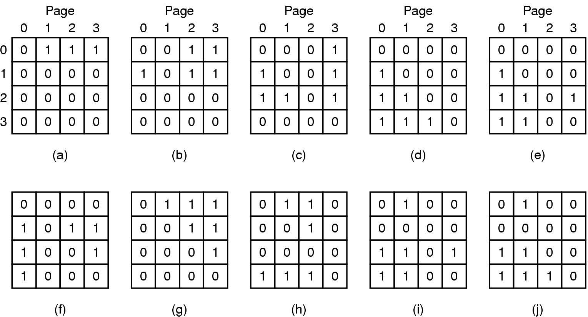
Simulating LRU in Software (1)
LRU using a matrix – pages referenced in order 0,1,2,3,2,1,0,3,2,3

